Slide 1

Sales Presentation

Slide 2
Data Modeling
The data was divided into
Orders
Customers
Products
Customer id/order id/order date/ ship date/ ship mode/ product id/ sales.
Customer id/ customer name/ segment/ country/ city/ state/ postal code/ region.
Product id/ category/ sub category/ product name.

Slide 3
Questions :
What is the total sales?
Chart: Bar chart showing total sales for each region.?
How do sales vary by product category?
Chart: Pie chart or bar chart displaying total sales for each product category.
Which customer segments generate the most revenue?
Chart: Bar chart showing total sales by customer segment.
What is the marker performance monthly?
Chart : Can use different types of charts.

Slide 4
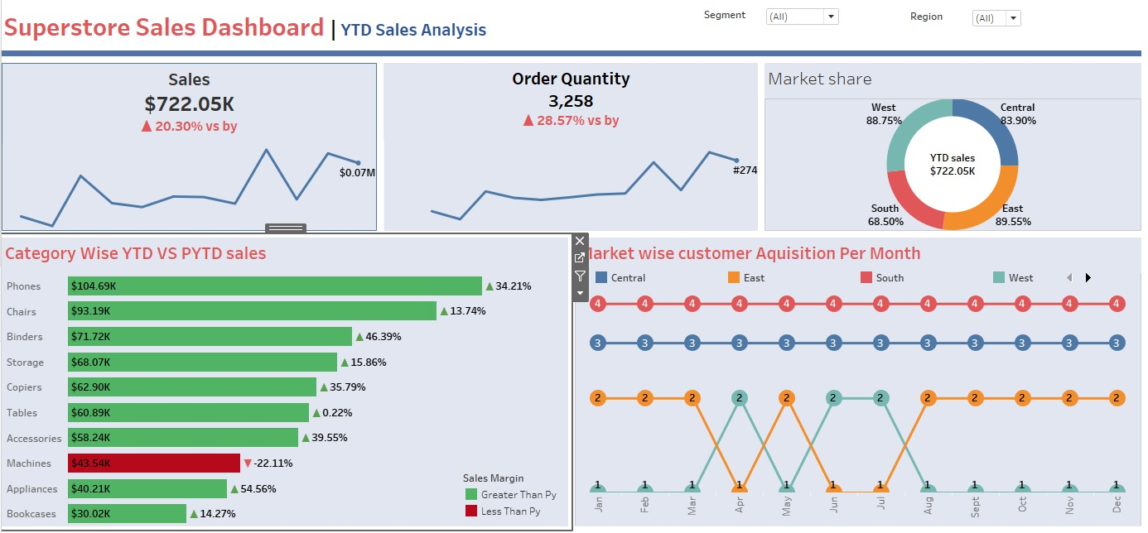

Slide 7
Market wise customer Acquisition per Month

Slide 8
Category wise YTD vs PYTD sales

